Slide 1
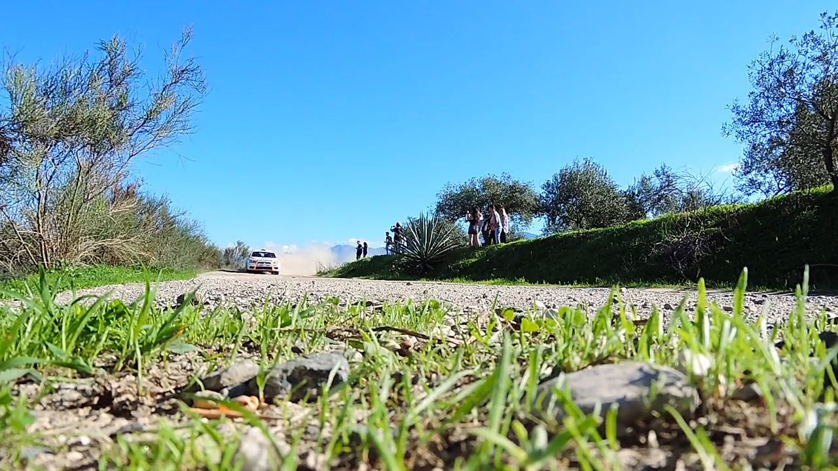
1.目標
Notes:
https://pixabay.com/videos/rallye-car-race-rally-drifting-1295/

Slide 2

2.阻礙
Notes:
https://pixabay.com/videos/pay-money-dollar-hands-currency-20857/

Slide 3
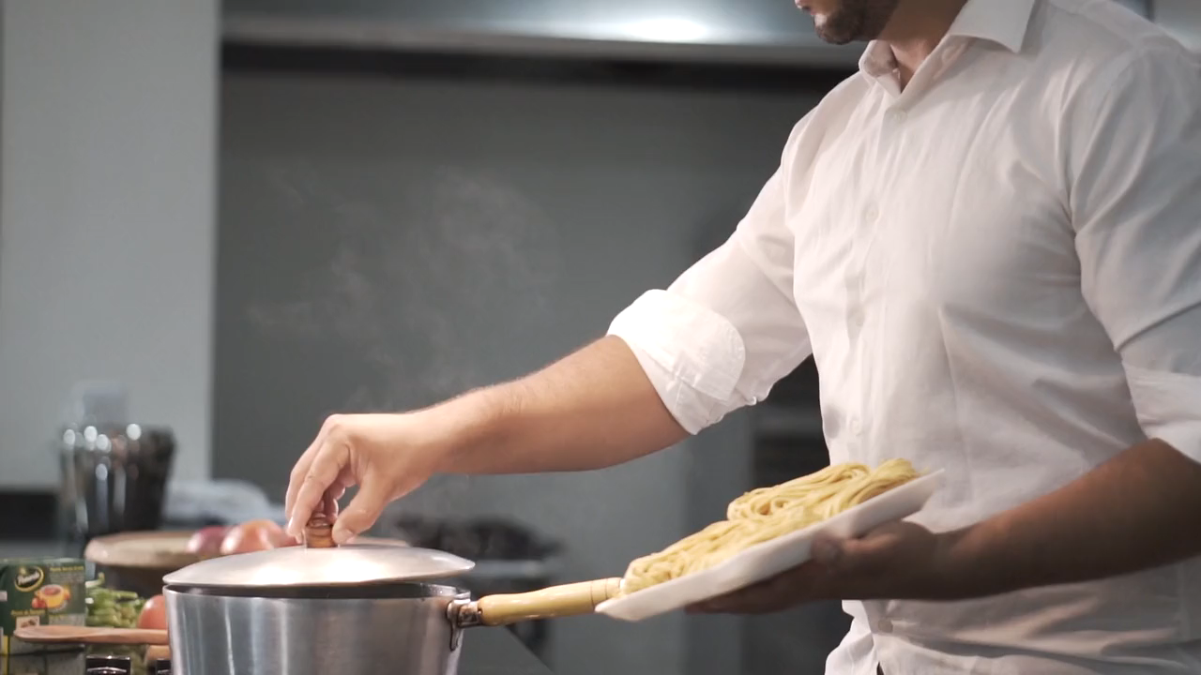
3.努力
Notes:
https://pixabay.com/videos/pasta-food-pastas-eat-nutrition-33256/

Slide 4

4.結果
Notes:
https://pixabay.com/videos/heartbroken-upset-sorrow-187521/

Slide 5
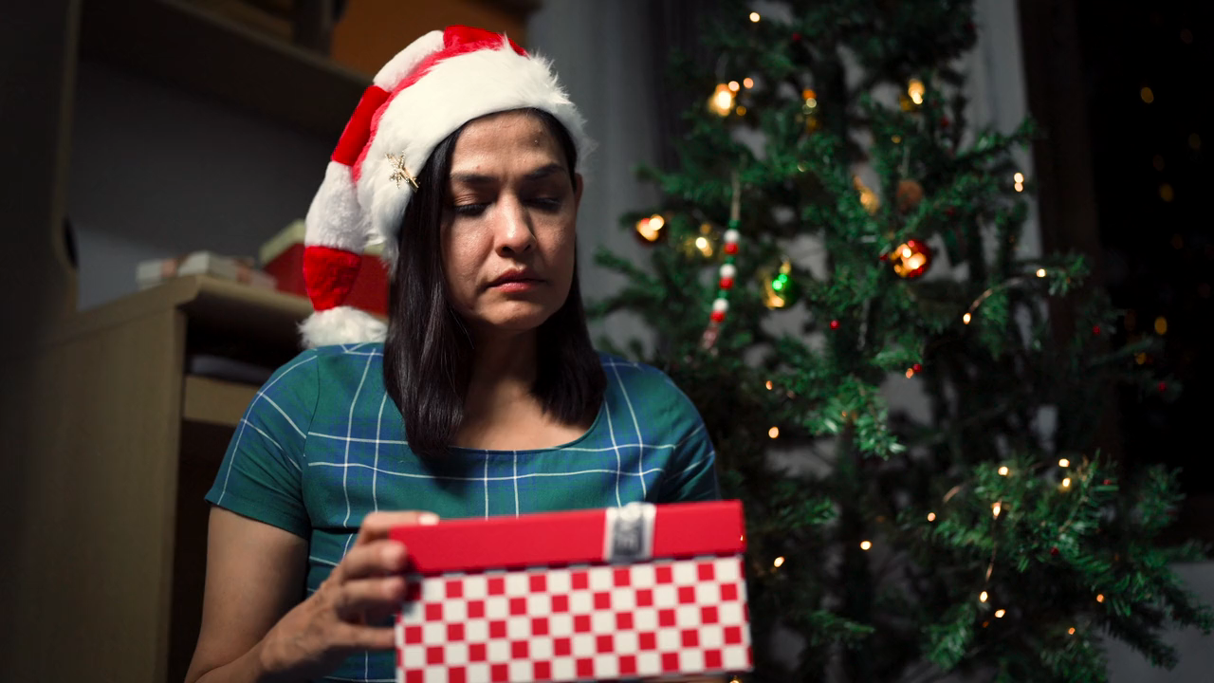
5.意外
Notes:
https://pixabay.com/videos/gift-happy-joy-celebration-186537/

Slide 6

6.轉彎
Notes:
https://pixabay.com/videos/search/happy/

Slide 7
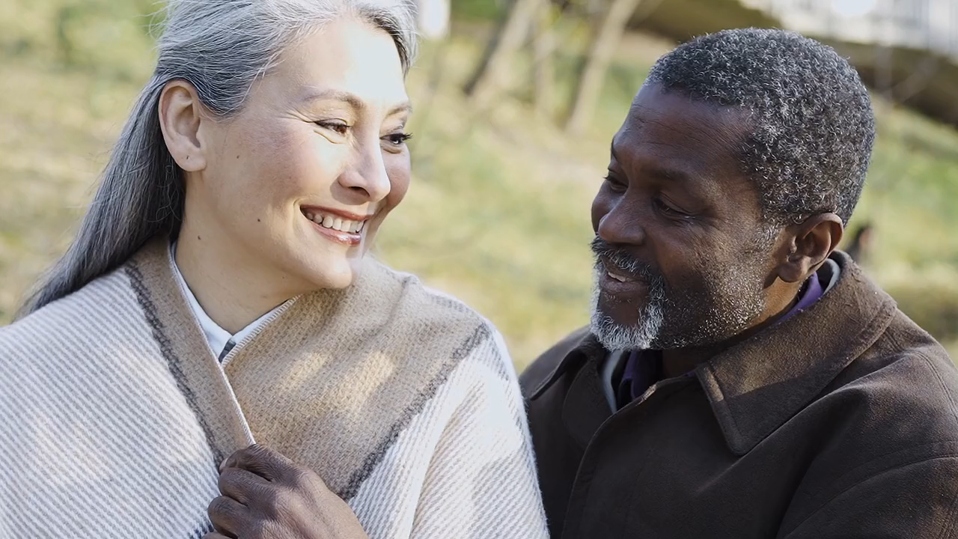
7.結局
Notes:
https://pixabay.com/videos/love-couple-park-old-care-friends-151194/

